Slide 1
Fit & Fun
AI-Powered Workout Companion

Slide 2
Table of Contents
Introduction to the Project
System Design and Architecture
Key Features of the App
Implementation Details
Screenshots
Challenges Faced and Solutions Implemented
Conclusion and Future Work

Slide 3
Introduction

Slide 4
Health and fitness are increasingly important in today’s digital age.
The Fit & Fun app was conceived to help users maintain a healthy lifestyle.
AI-driven solutions were integrated to personalize user experiences.
The project aimed to create a user-friendly interface for fitness tracking.
Initial plans included both workout and diet planning functionalities.

Slide 5
Objectives included creating customizable workout and diet plans.
Target audience: health-conscious individuals seeking personalized plans.
The app was expected to improve user adherence to health routines.
Key features were designed to simplify and enhance user experience.
Overall, the app aimed to positively impact users' health and fitness goals.

Slide 6
Key Features
Designed and developed AI Workout Planner
Workout plans are tailored to the user physical fitness levels and their goals.
High level UI is used for all components to make things clear and crispy.
User Progress Tracker uses “Dynamic User Interface” where based on user plan preference the UI changes itself.
Diet Plans are made with few important parameters and still needs Improvements to get perfect Diet Plan.
Users can seamlessly use different components at once without having trouble.

Slide 7
System Architecture

Slide 8
The system architecture was designed to be modular and scalable.
Core components included the frontend, backend, and database.
The architecture diagram illustrates data flow between components.
The system was built to handle secure user data and interactions.
The frontend and backend communicated seamlessly through APIs.

Slide 9
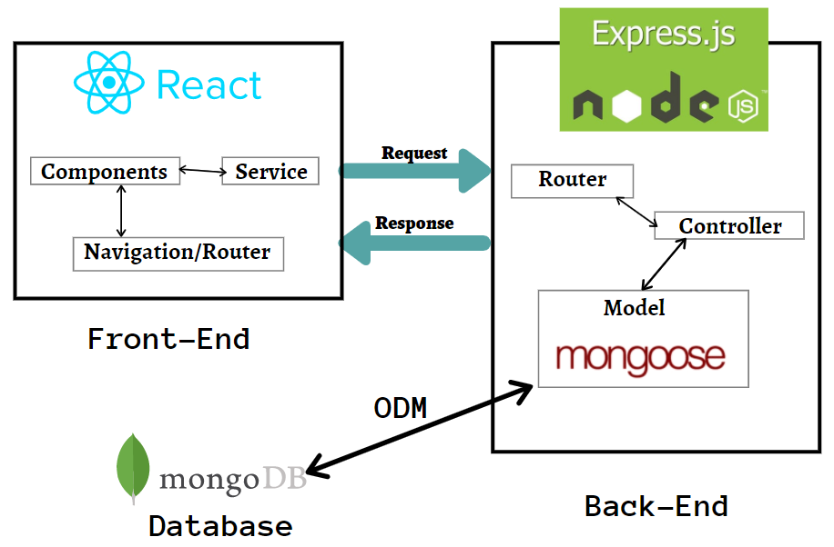

Slide 10
The architecture diagram shows the integration of key components.
Security protocols were implemented to protect user information.
Scalability was a priority, allowing future expansion of features.
External services, like ChatGPT, were integrated for enhanced functionality.
The database design supported efficient data retrieval and storage.

Slide 11
Feature Highlights

Slide 12
The Workout Planner allows users to customize their exercise routines.
Users receive daily and weekly exercise plans tailored to their needs.
The app offers options to set primary and secondary workout plans.
The user interface is intuitive, making workout planning straightforward.
The planner adapts to user progress and feedback.

Slide 13
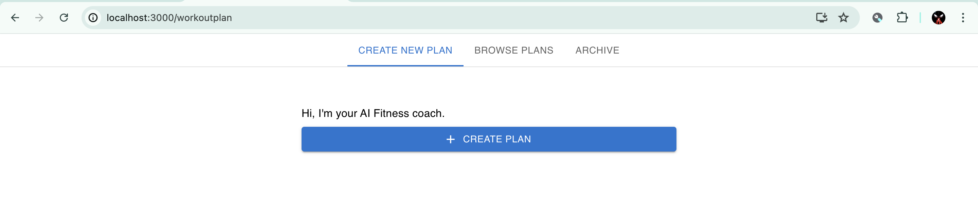
Workout Planner Page mainly consist of Three Tabs
Create New Plan
Browse Plans
Archive

Slide 14
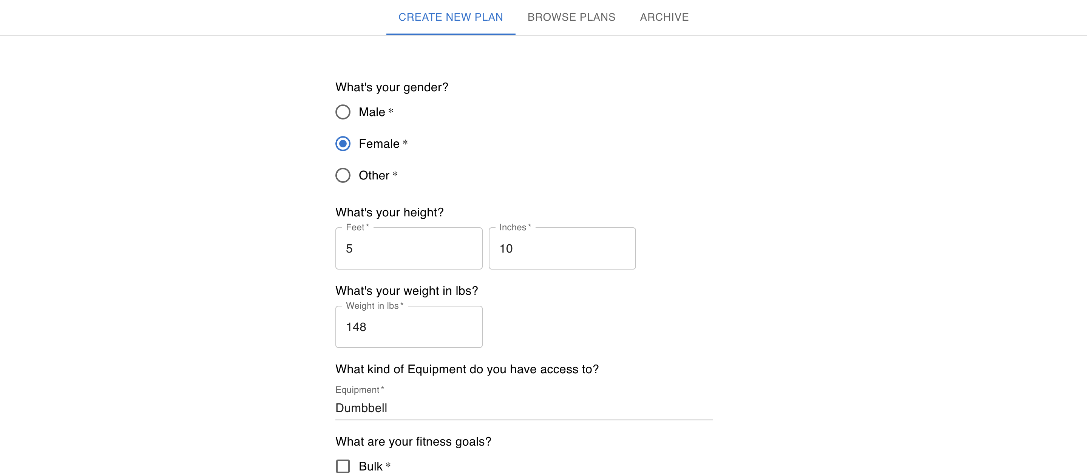
Create New Plan

Slide 15
This Tab helps user to create their own workout plan
React State Managements is used to collect different kinds of data as input from the User
These Data includes Gender, Height, Weight, Fitness Goals ( Bulk, Cut, Healthy, Increase Energy ), Muscle Group to focus on ( Abs, Chest, Upper Body, Lower Body, Legs, Full Body )
By the end when user clicks on submit the response of the user are added to request body by the React State.
This request body along with other user data like username, email, isAuth are sent to the Server for generating plan.

Slide 16
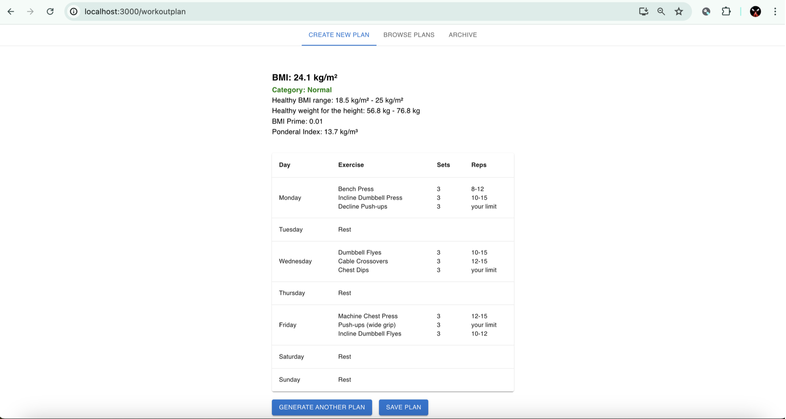
Generated Plan

Slide 17
The Diet Plan feature personalizes meal plans based on preferences.
Nutritional information is provided for each meal, helping users track intake.
The interface allows easy switching between diet plans.
Users can choose from various dietary preferences like Keto, Vegan, etc.
The diet plan complements the workout planner for holistic health management.

Slide 18
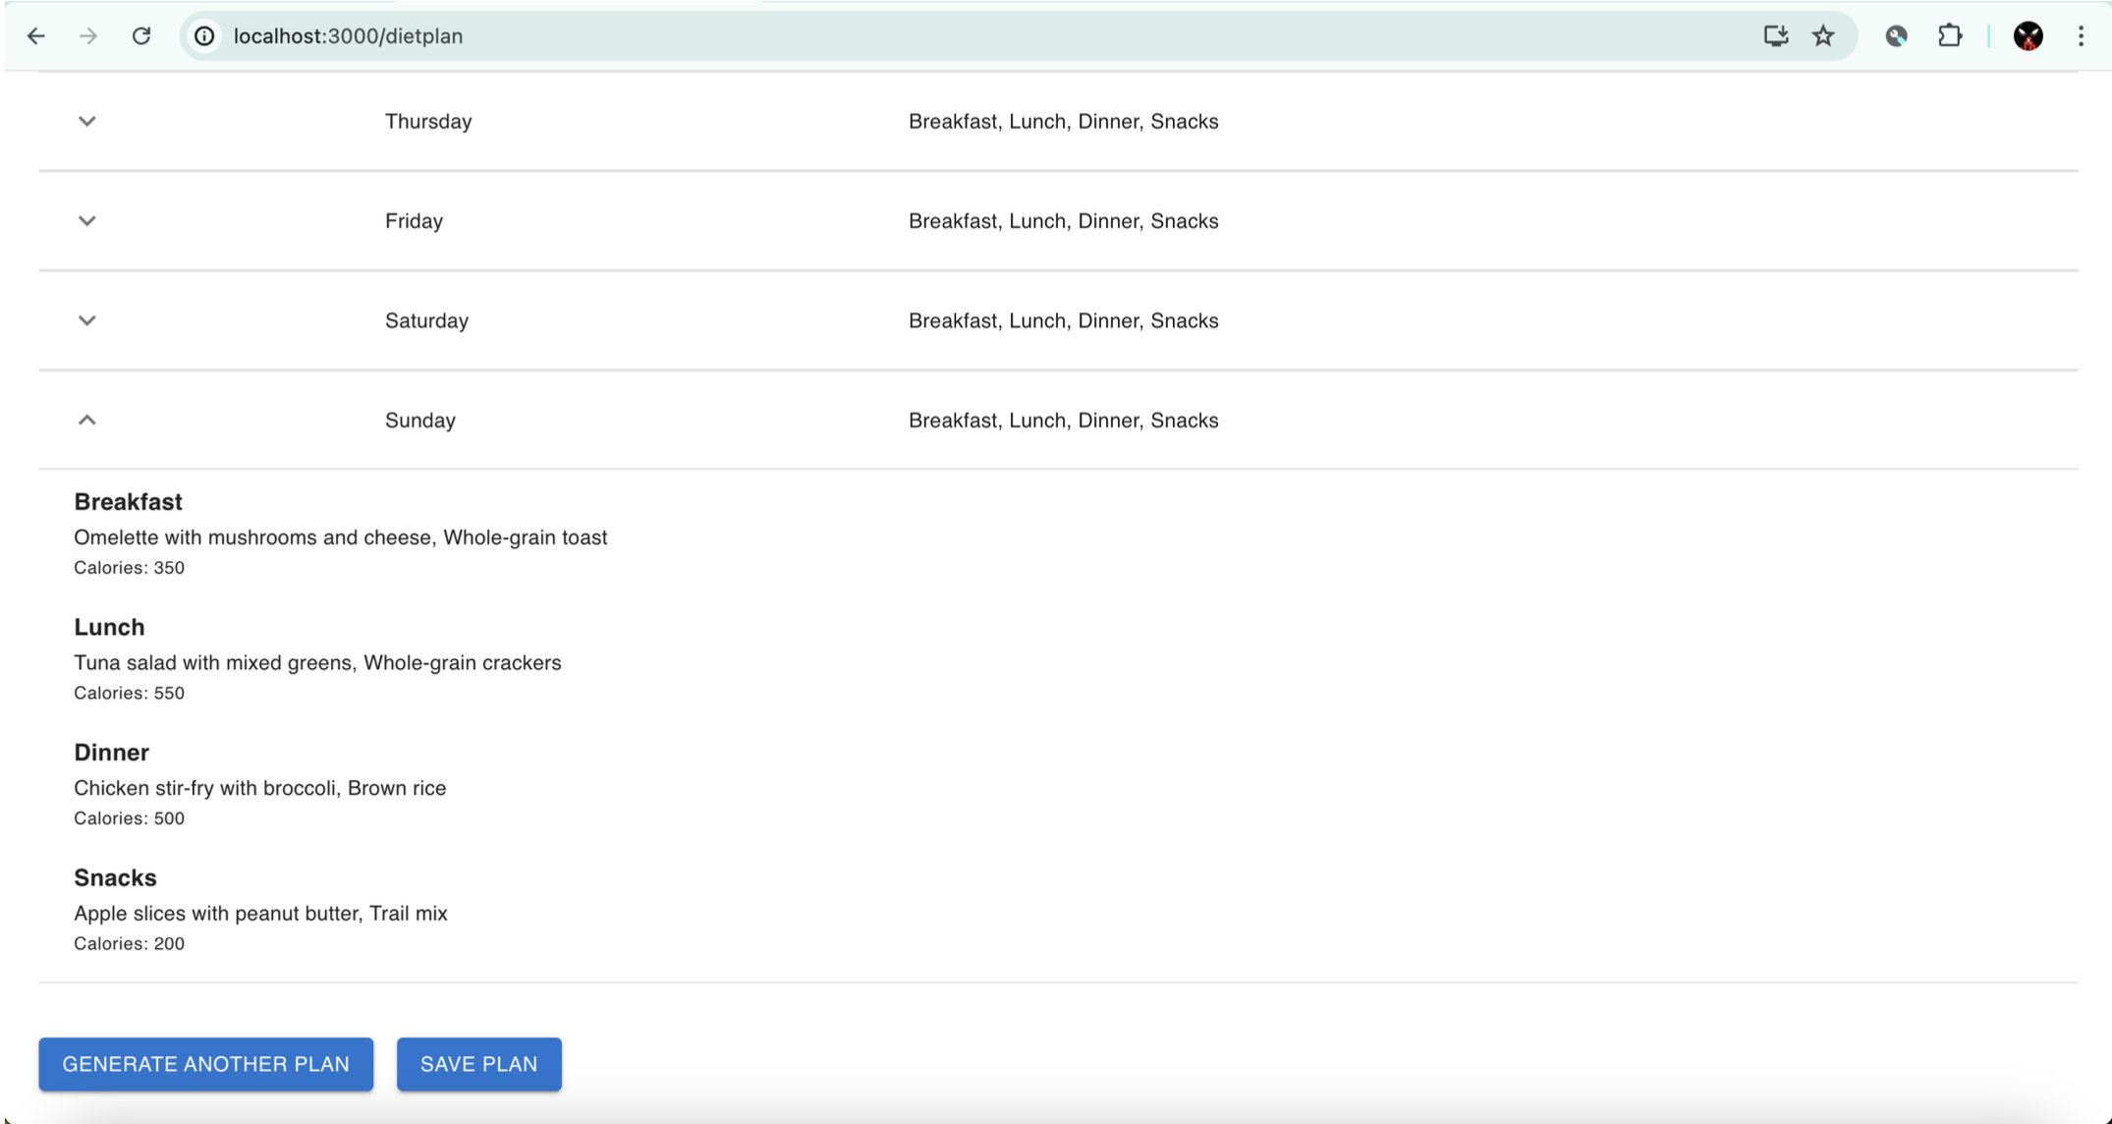

Slide 19
Implementation Details

Slide 20
The backend was developed to handle complex data processing efficiently.
The ChatGPT API was integrated to generate personalized plans.
Data was securely handled using MongoDB as the database solution.
JWT authentication ensured secure access to user accounts.
Backend components were modular, facilitating easy updates and maintenance.

Slide 21
The frontend was developed using React for dynamic user interactions.
A persistent drawer navigation provided a seamless user experience.
The user profile management allowed updates to personal information.
Data validation was implemented to ensure accurate user inputs.
The frontend and backend communicated via RESTful APIs.

Slide 22
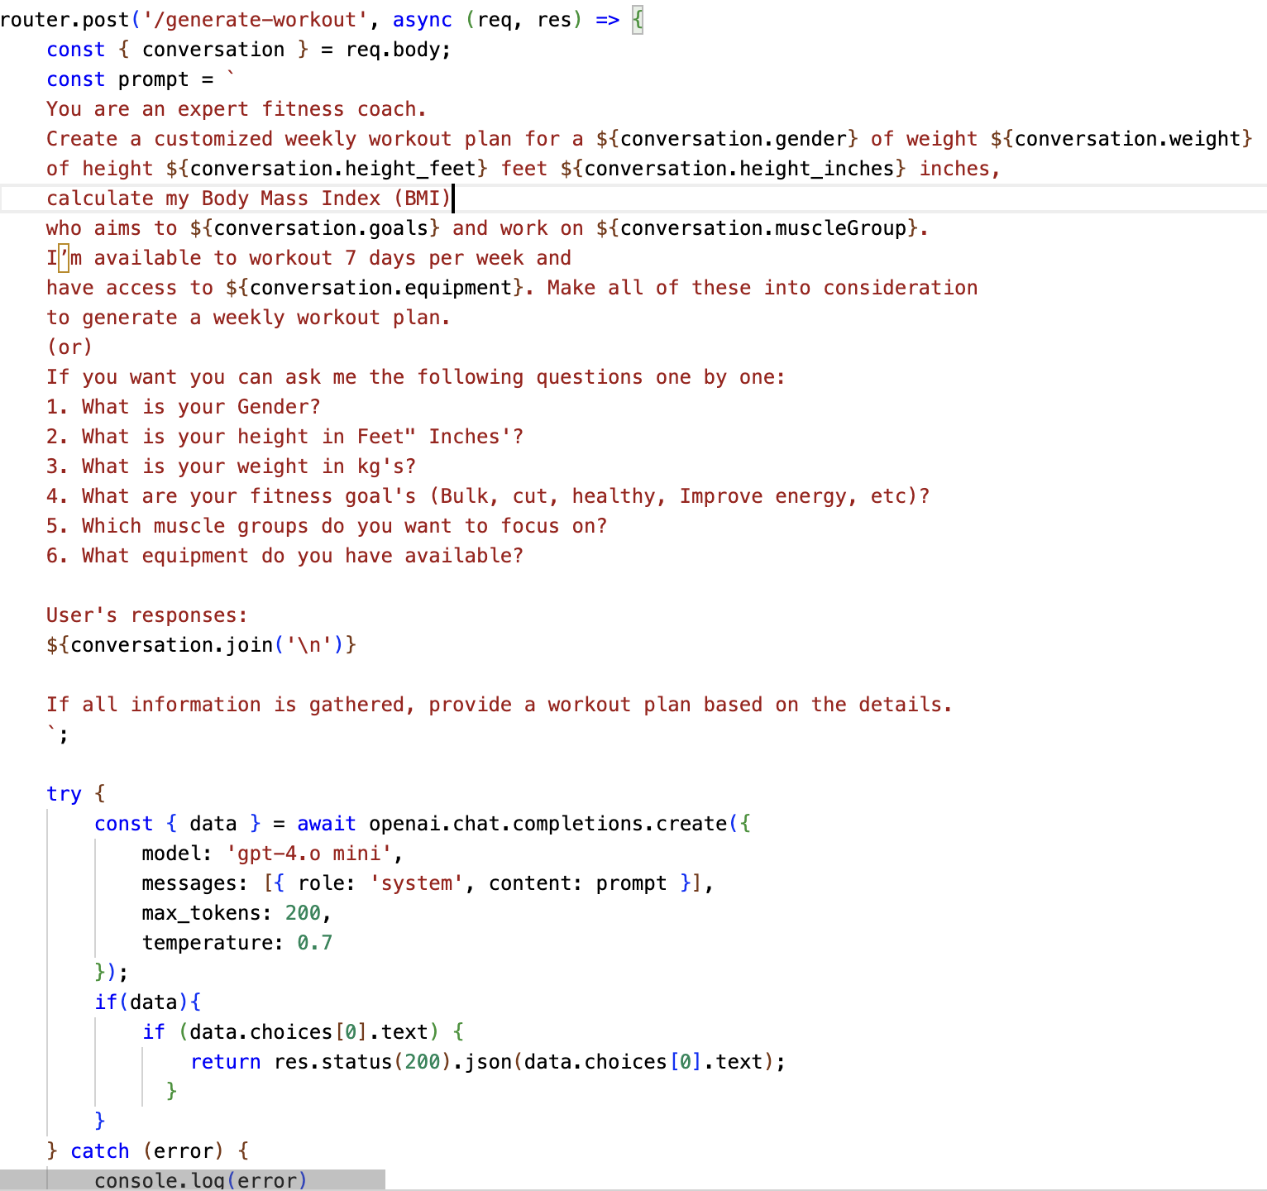
Generating plan at backend
With the help of openAI API, we are posting a request to the ChatGPT’s “gpt-4.o mini” Model.
We then store the user response in a variable called conversation.
From then we use a professional prompt and generate workout plan.
This plan is again sent back to the client.

Slide 23
Making a plan from response
As the server sends the response back to the client, we then format the data to build a clean UI.
The formatted data is used to build our workout plan using a clean and simple table along with other stylings.
The workout plan for a week is displayed for the user along with their BMI status.
Now user can choose to save workout or generate another plan if needed.
Saved plans will be displayed under Browser Plans Tab.

Slide 24
Screenshots

Slide 25
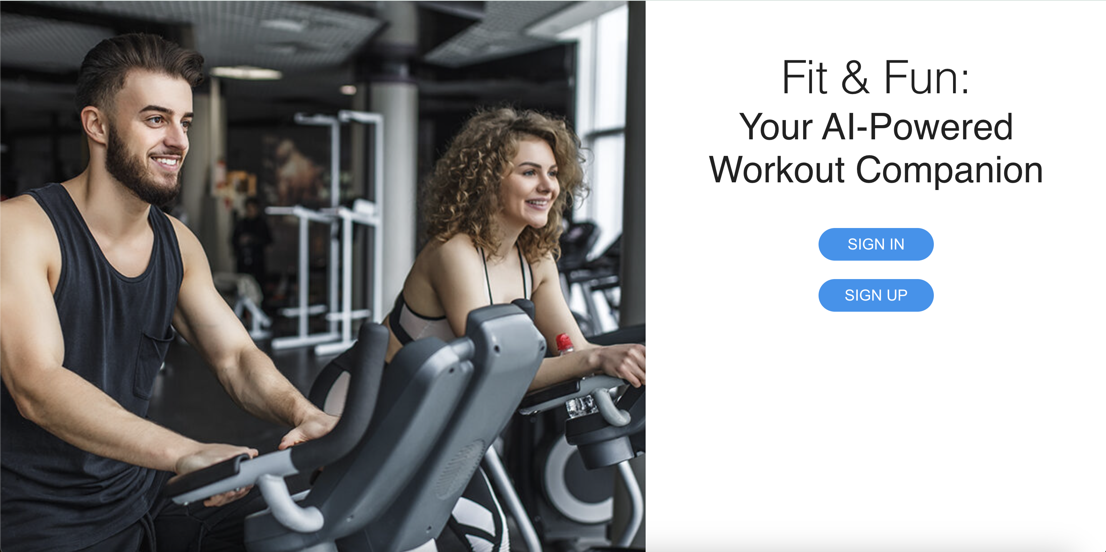

Slide 26
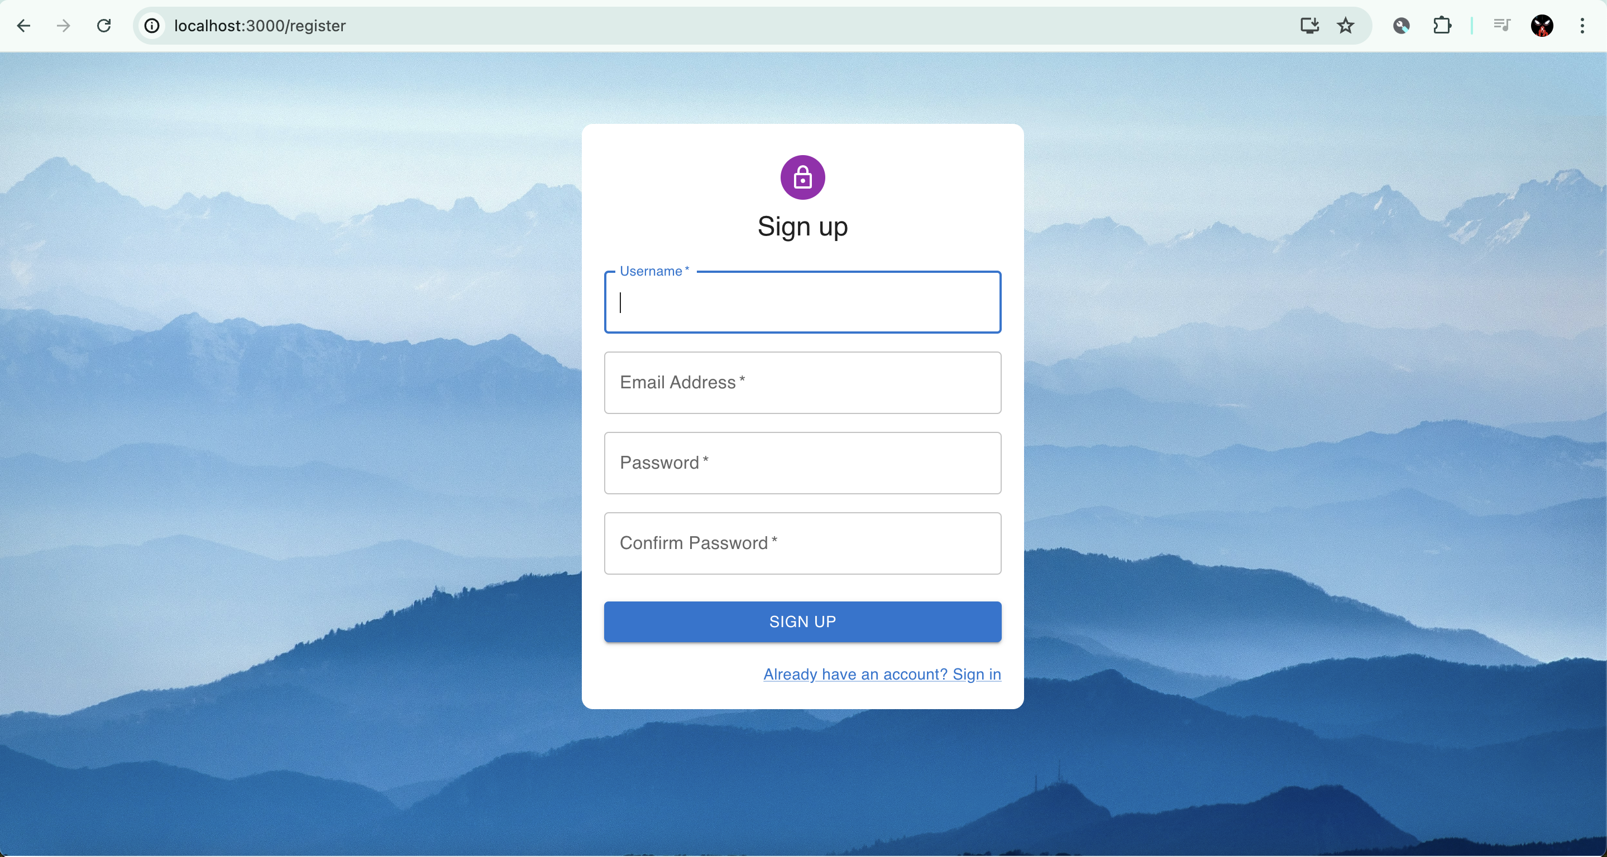

Slide 27
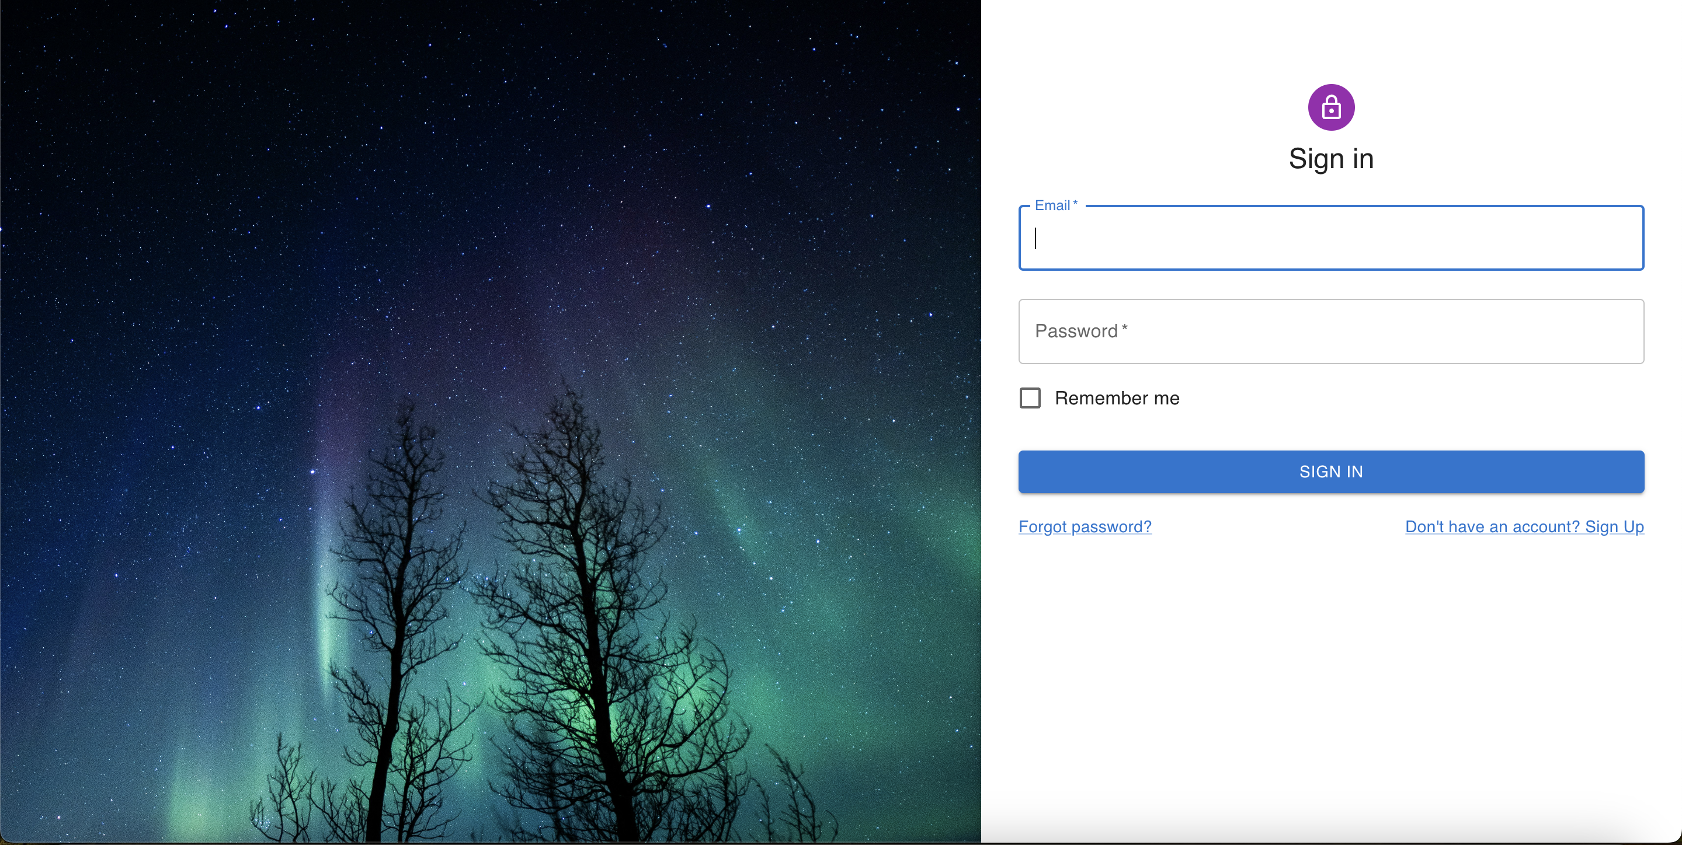

Slide 28
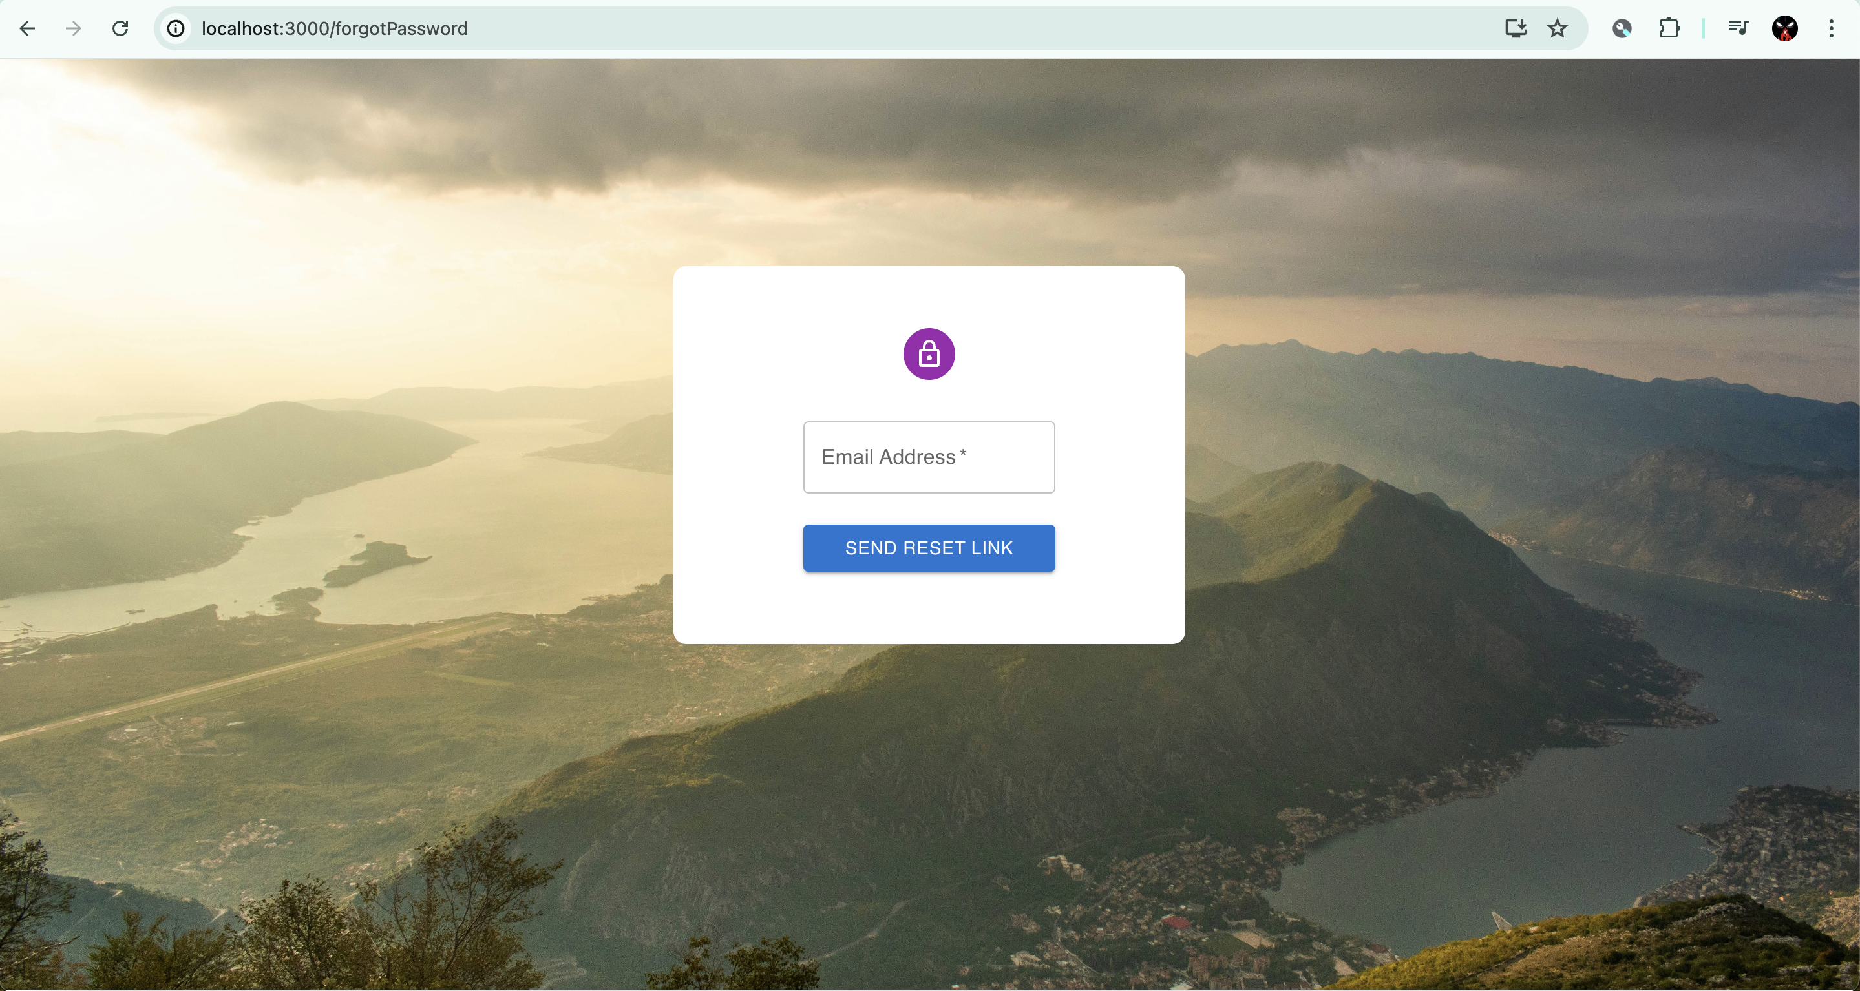

Slide 29
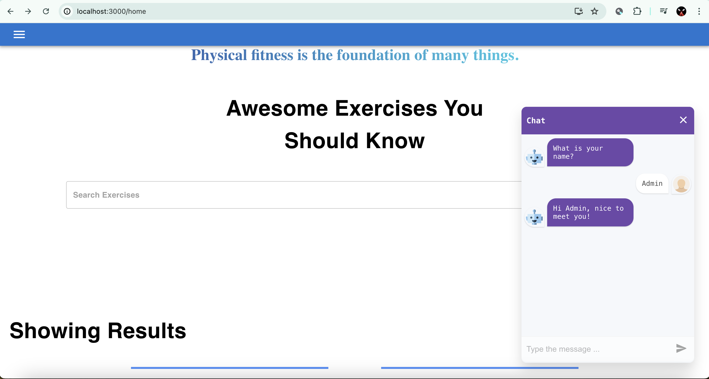

Slide 30
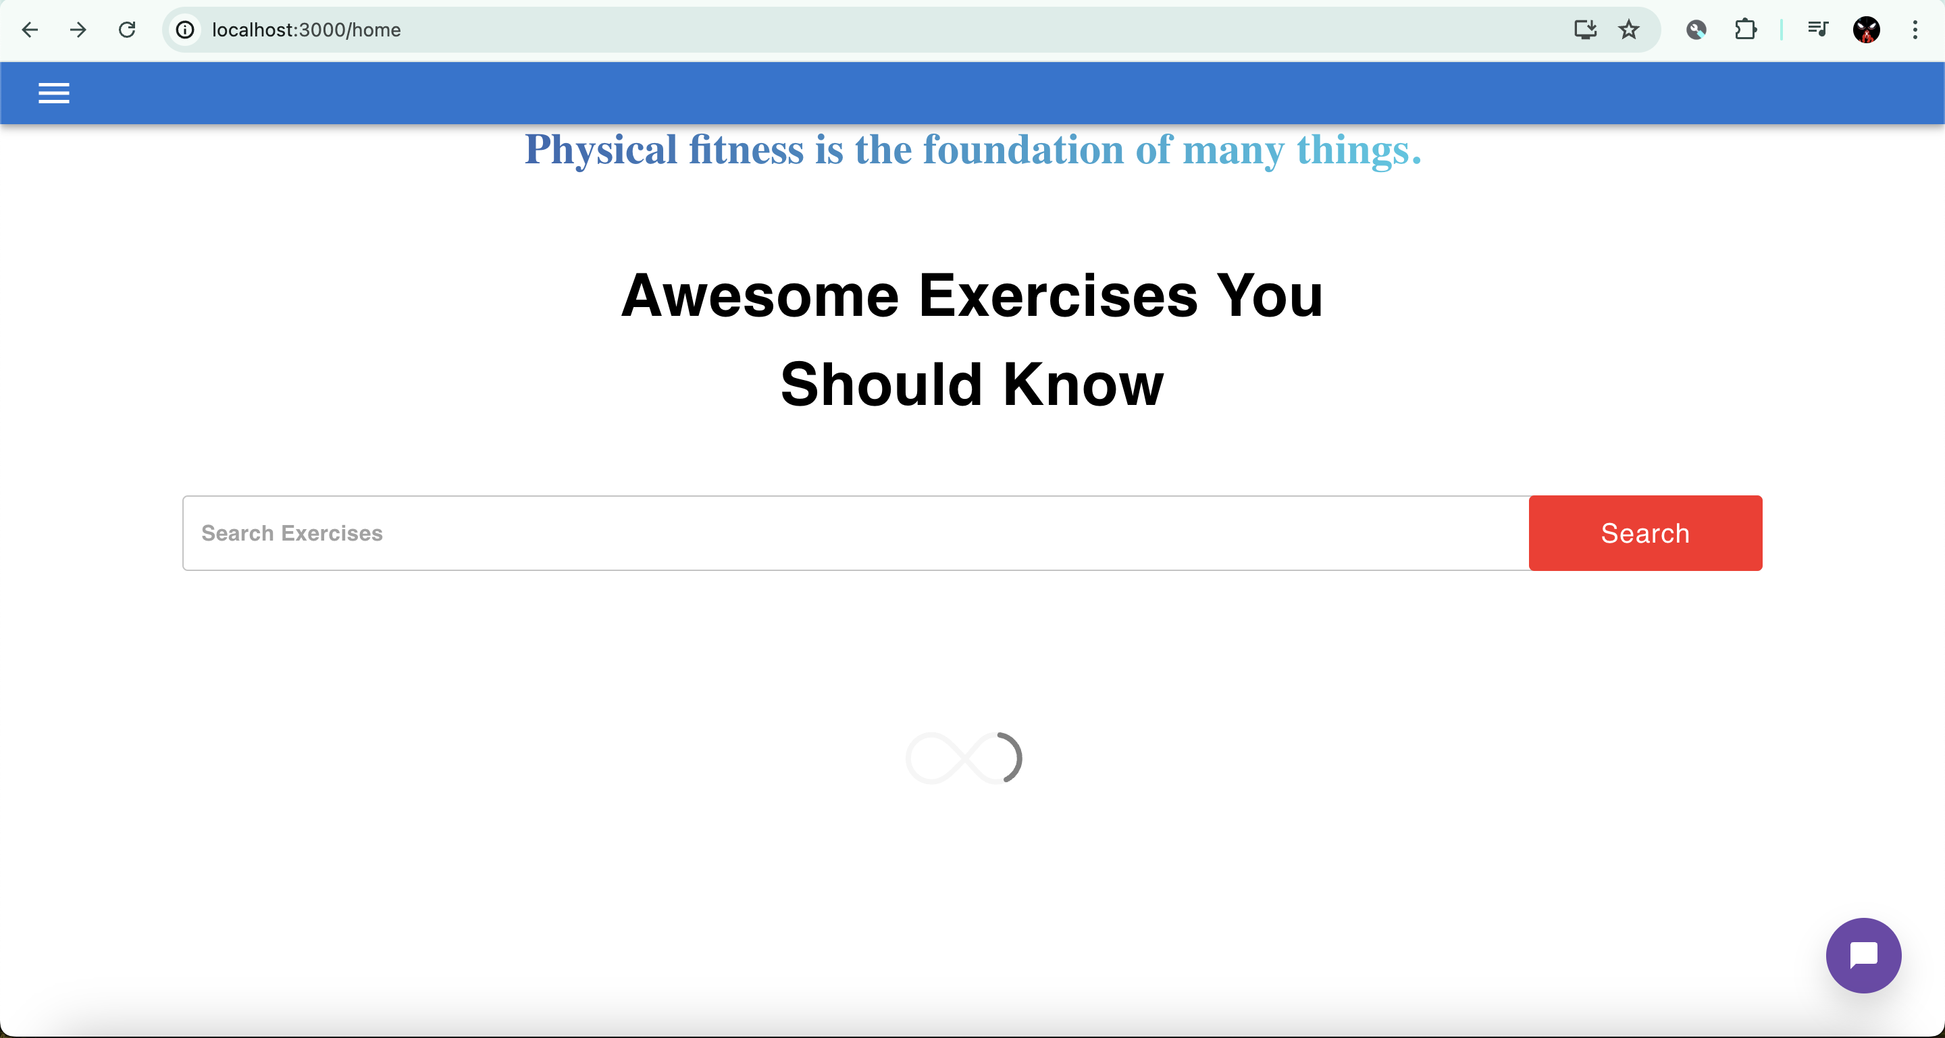

Slide 31
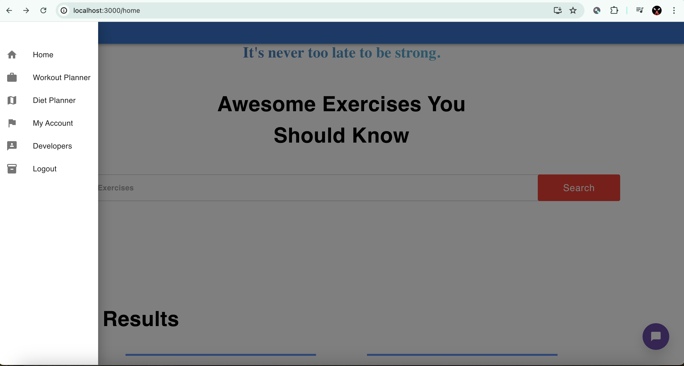

Slide 33

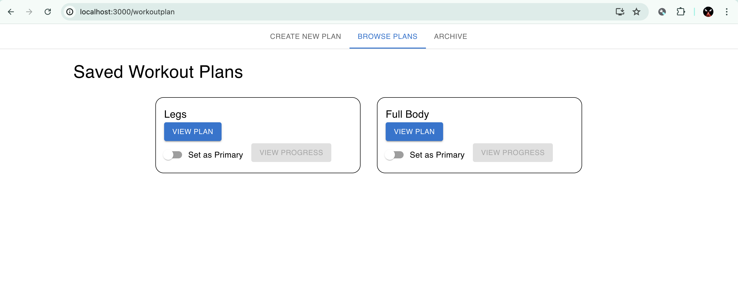

Slide 34
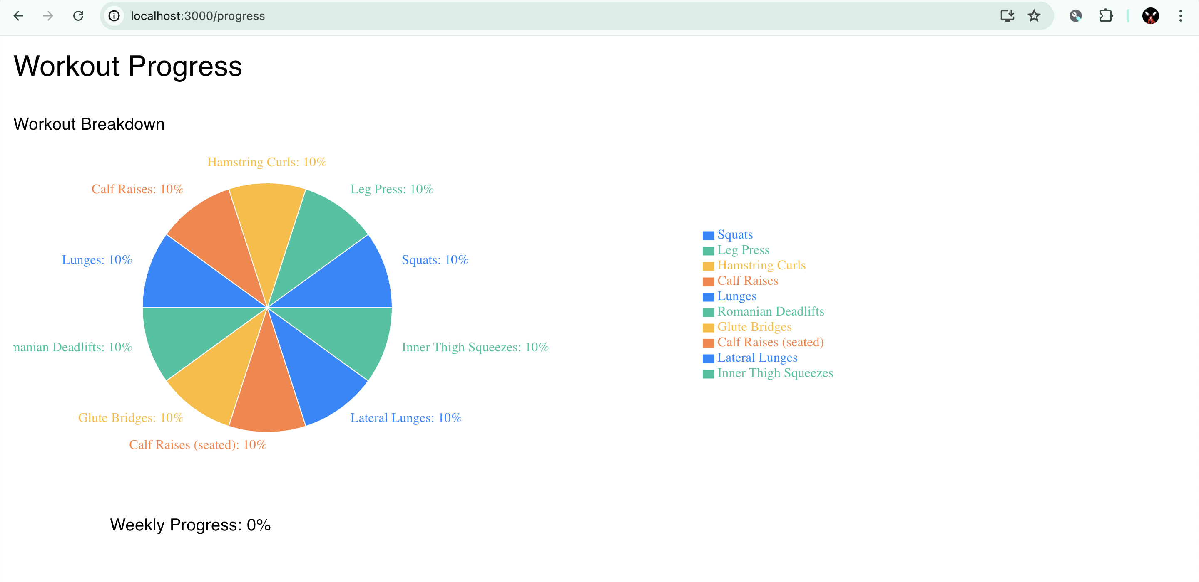

Slide 35
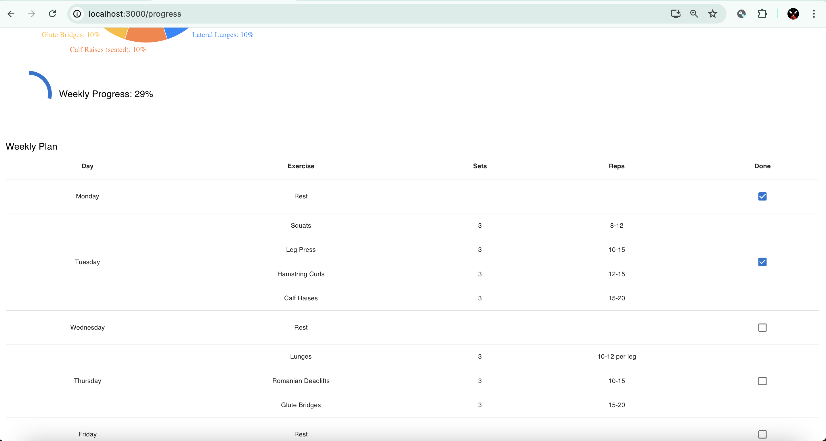

Slide 36
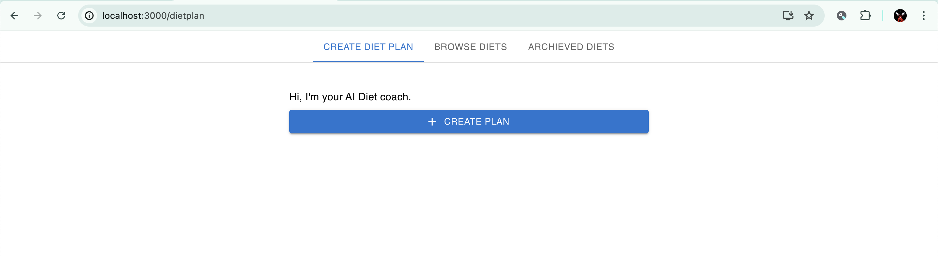

Slide 37
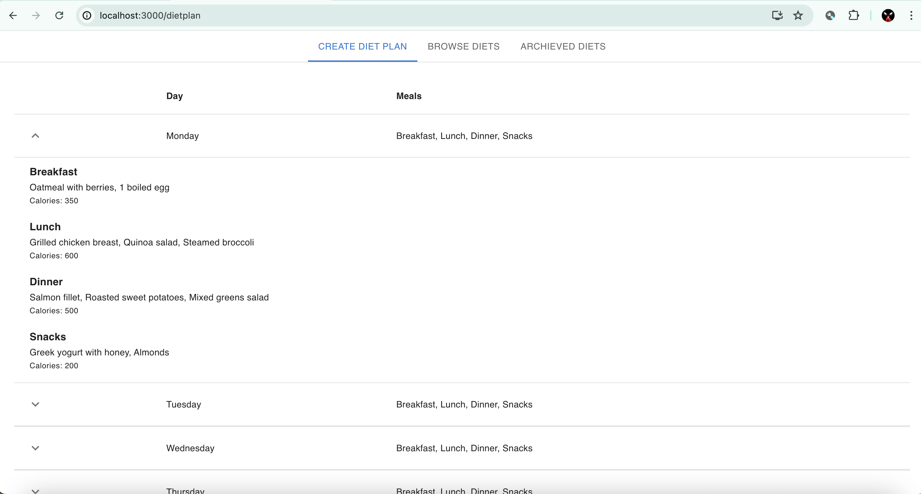

Slide 38


Slide 39
Challenges and Solutions

Slide 40
Integrating the ChatGPT API presented technical challenges.
Managing large datasets required optimization for performance.
User authentication needed to be secure yet user-friendly.
Ensuring cross-platform compatibility was essential for broader reach.
Coordination among team members was vital to address these challenges.

Slide 41
API issues were resolved by refining requests and optimizing calls.
Data management was improved through indexing and optimized queries.
Security enhancements included encrypted data storage and secure login.
Extensive testing was conducted to ensure compatibility across devices.
Team collaboration was strengthened through effective communication.

Slide 42
Conclusion
The Fit & Fun application successfully achieved its goals.
Team collaboration played a crucial role in the project’s success.
The application effectively supports users in maintaining healthy habits.
Lessons learned will inform future projects and enhancements.
The project was a valuable learning experience for all team members.

Slide 43
Continue…
Future work will focus on expanding features and improving UX.
Potential enhancements include new workout and diet options.
The app could be scaled to support more users and advanced features.
The project’s success sets the foundation for continued development.
Thank you for your attention and support throughout this journey.

Slide 44


Thank you

